Slide 1
GREN Map
Monthly Meeting
November, 12

Slide 2
Agenda
Progress on PoC Development
GNA-G Projects Map
NRENs Maps
Netbox to GRENML to Netbox
GRENMLs Repository
Discussions

Slide 3
Expanding GRENMAP Visualizations
Recent Focus
Adapted two new visualizations for GRENMAP:
Global Network Advancement Group (GNA-G) map — displaying international links interconnecting multiple national research and education networks (NRENs).
NREN Topology View — consolidating topologies from several NRENs, including Arnes, CEDIA, FCCN, FUNET, GARR, HEAnet, RNP, and REUNA.
Goal
Enhance GRENMAP’s role as a global visualization tool for research and education networks.

Slide 4
Architecture, Reliability, and Reusability
Technical Highlights
The GREN-MAP-DB-Node module proved to be robust and flexible, supporting seamless integration of the new visualizations.
Its modular architecture accurately represents each NREN’s specific topology.
Comprehensive unit and integration tests ensured stability and reliability throughout customization.
Broader Impact
Detailed project documentation enables other organizations to deploy custom GRENMAP instances.
The system’s decentralized and extensible database design fosters wider adoption and collaboration across the global R&E community.

Slide 5
GNA-G Projects Map

Slide 6
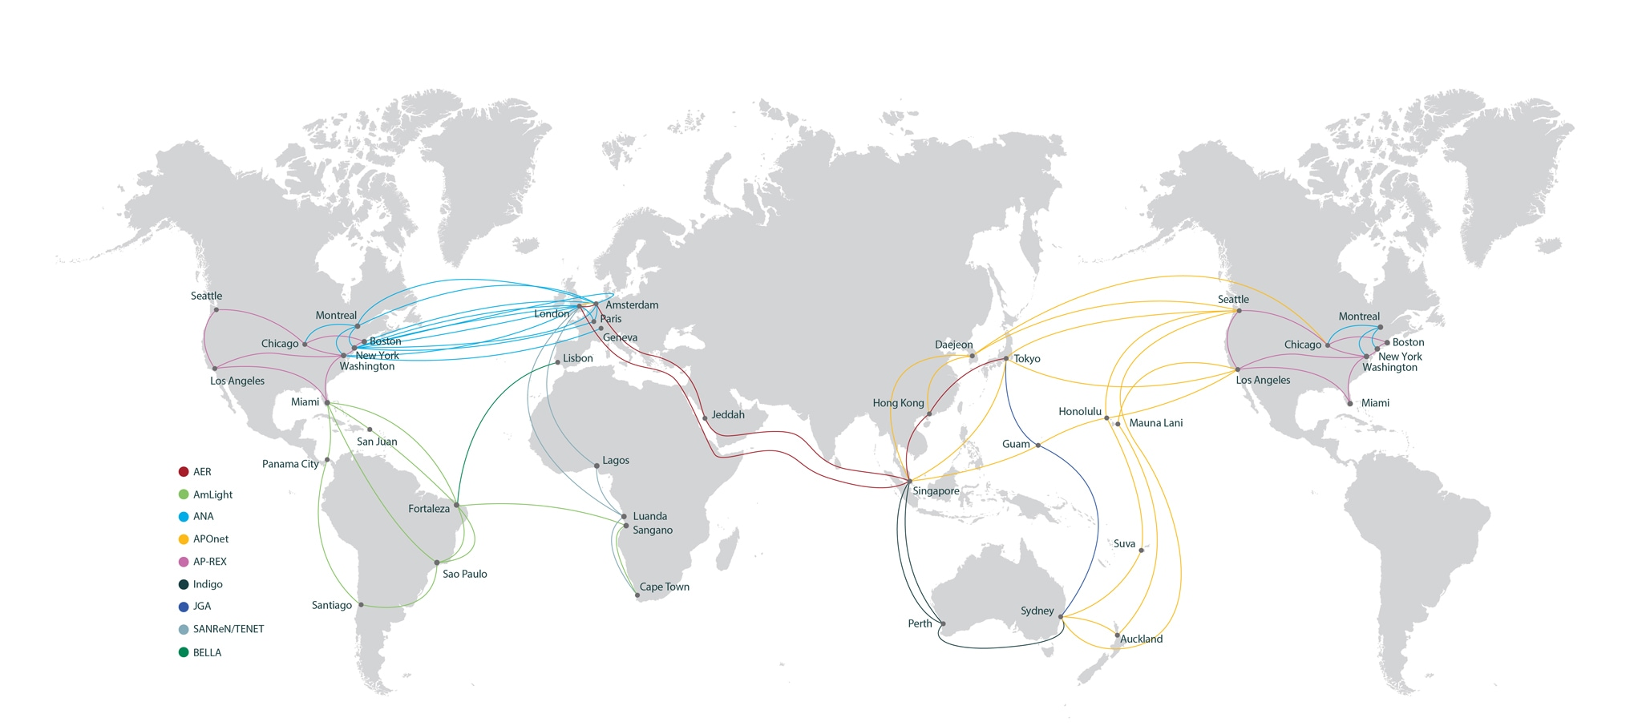
GNA-G Projects Map
https://www.gna-g.net/

Slide 7
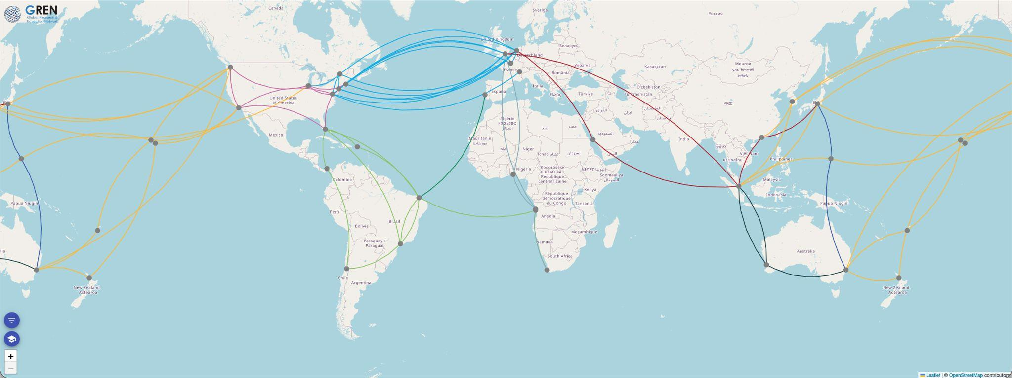
GNA-G Projects Map

Slide 8
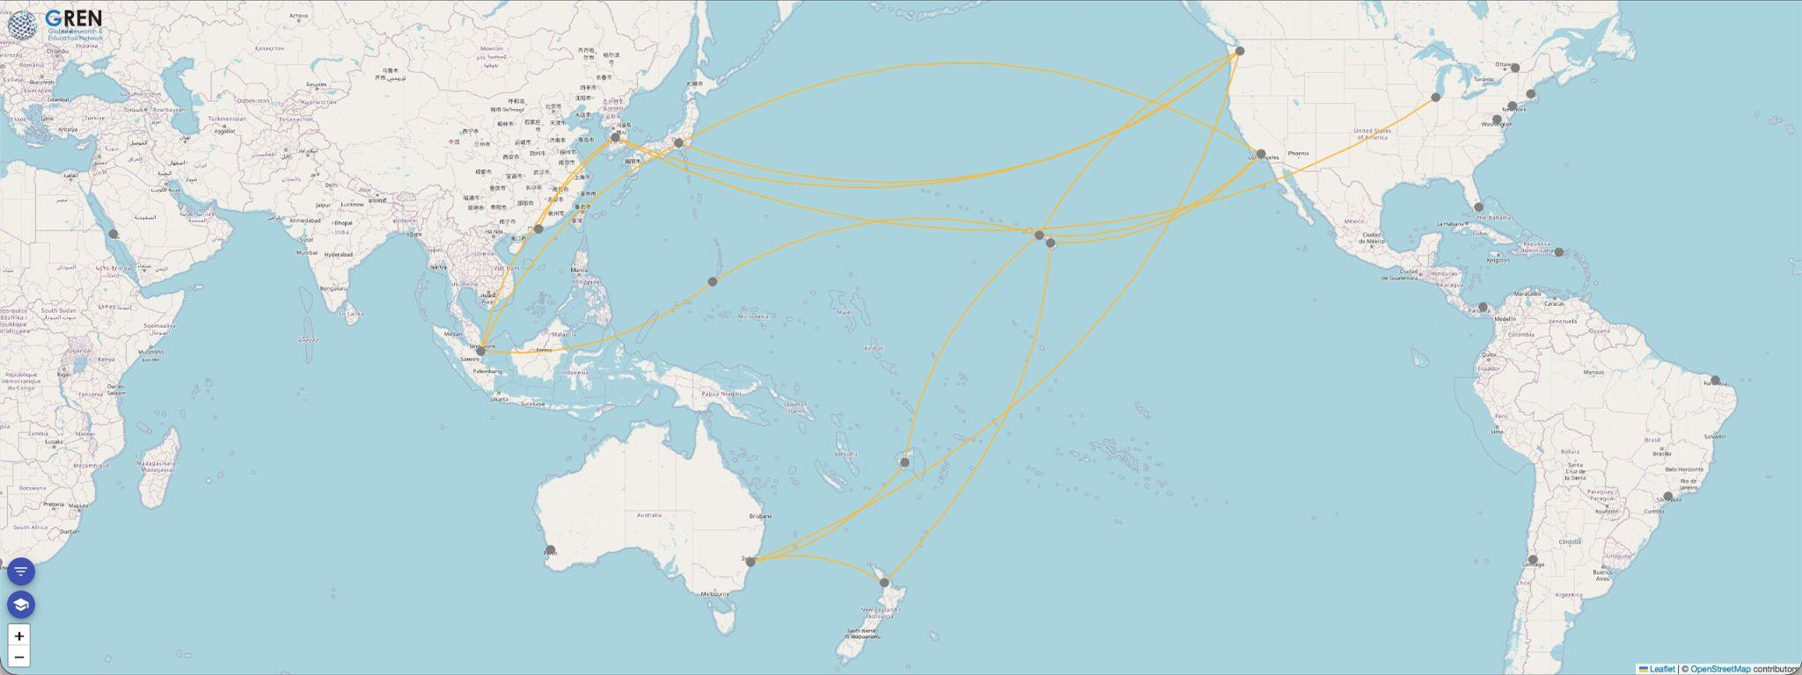
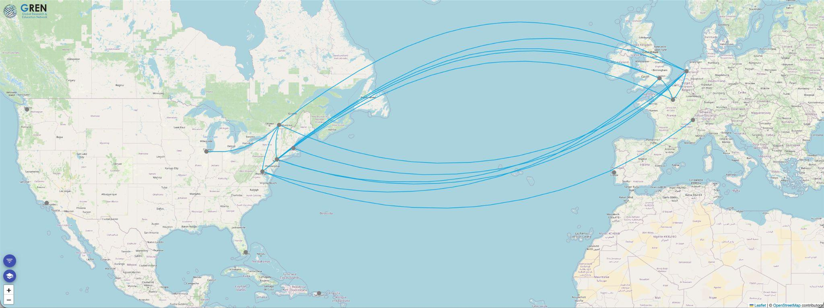
APOnet
ANA

Slide 9
NRENs Maps

Slide 10
NRENs Map
Objective
Now: create a base of NREN topologies.
Then: engage the NRENs to update this data (which is already public).
Data Source
Publicly available network maps from NRENs.
GÉANT Compendium used as the primary source (https://compendium.geant.org/network-map).
Processing
Some were inserted "by hand".
Some had their GRENML file created by GenIA.
PoC Selection Criteria
NRENs were selected based on the ease of converting their public maps into the GRENMAP format.

Slide 11
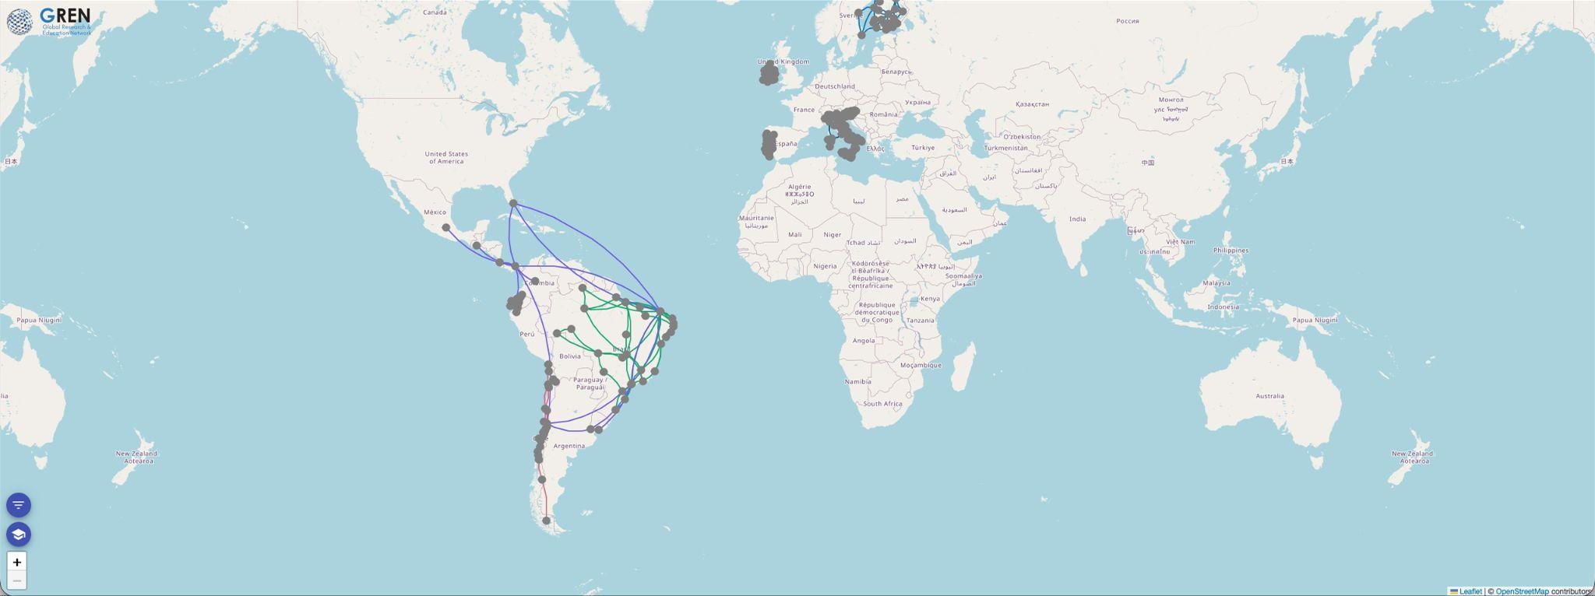
NRENS Maps

Slide 12
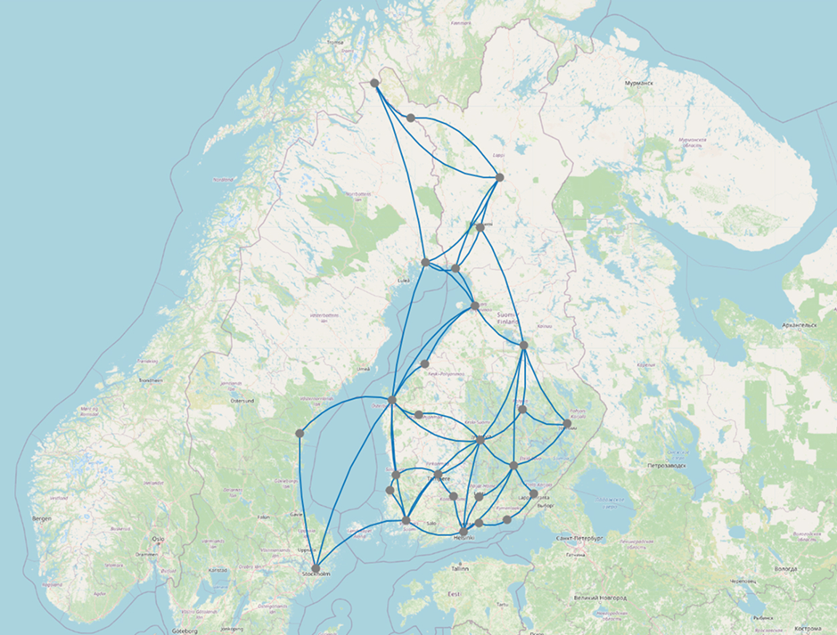
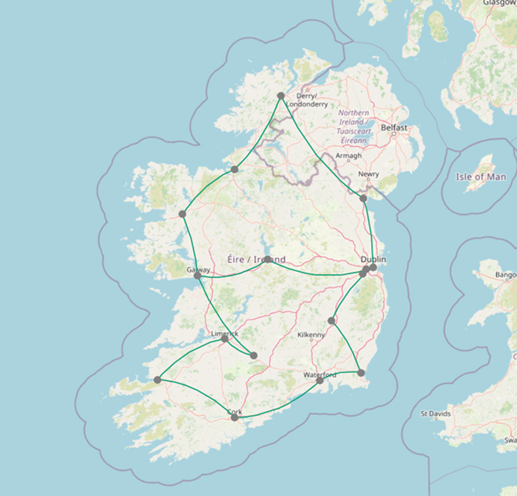
HAEnet – Ireland
FUNET – Finland

Slide 13
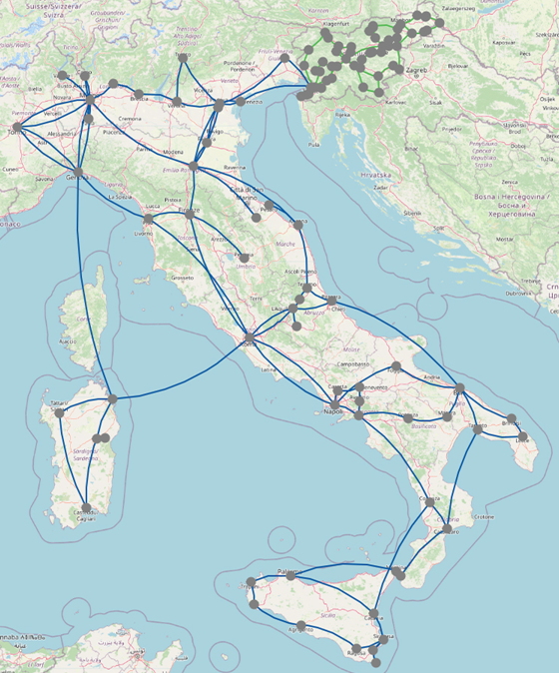
GARR - Italy
Arnes - Slovenia

Slide 14
NRENs Maps - Next Steps
Keep adding NRENs
Add intercontinental networks (e.g. NORDUnet, RedClara,...)
Propose an official infrastructure for hosting maps with an official URL defined by WC

Slide 15
Netbox to GRENML to Netbox

Slide 16
Netbox to GRENML - The first steps
Problem
Need to anonymize data in order to make it public, create digital twins, virtual labs, etc.
Multiple NRENS have their topology data in databases such as Netbox.
Objective
Now: Create a PoC for the translation of data from Netbox to GRENML.
Then: Update this PoC in order to be able to receive, anonymize, and return a new file in Netbox or GRENML accepted file types.
The PoC so far
Able to anonymize:
Location
Device’s Interfaces
Device’s addresses
Additional information collected from Netbox
Able to aggregate by:
Device
Site
Owner/Tenant

Slide 17
Netbox to GRENML
Next steps
Anonymize link information (currently, only link capacity is being obfuscated).
Anonymize device name or specific information that allows for identification.
Create the return file to Netbox.
Incorporate/Create an GUI to make this application public and easy to use.
Test in multiple environments.

Slide 18
Live Demo

Slide 19
GRENMLs Repository

Slide 20
GRENMLs Repository
We are progressively releasing all generated topologies to the GRENML Repository.
We are transitioning the repository structure from PoC-based aggregation to an NREN-based organization.
Find them here: https://github.com/grenmap/GRENML-Repository

