Slide 1
Meeting with Mandated Organisations
30 October 2025, 12:00 – 13:00 CET

Slide 2
Today’s Topic
General Assembly #12 / Wednesday, 10 December 2025
Draft Agenda of GA#12
Election of 3 new Board Members
Walk-through to “Neutral Paper” explaining possible implementation routes of FP 10 for addressing EOSC post-2027

Slide 3

GA#12, 10 December 2025
Draft agenda

Slide 4
GA#12, Agenda Items / Paperwork
Deadline for submission: 20 November
Paper | Title | Purpose
A | New Members & Observers | Decision
B | Status and evolution of the EOSC Federation | Information
C | Annual Report of the President and Secretary General | Information
D | Election of 3 new Board Members | Decision
E | “Neutral Paper” explaining possible implementation routes of FP 10 for addressing EOSC post-2027 | Information
F | Work Plan 2026 | Decision
G | Budget Proposal 2026 | Decision

Slide 5
GA#12 / Paper D
Election of 3 new Board Members

Slide 6


Slide 7






Organigram
Secretariat
Board of Directors
Task Forces
Fora
Secretary General
Ute Gunsenheimer
President
Klaus Tochtermann
Mandated Organisations
Technology
Finance & Administration
Marialuisa Lavitrano
Roxanne Wyns
LDTR
Funders
Statutory Auditor (Geert Keunen, VRC)
Sara Garavelli
Licia Florio
Interoperability
RPO Networks
Communications
Engagement
3-years terms
Suzanne Dumouchel
Ignacio Blanquer
Health Data
ESFRI RIs
Monitoring & Reporting
Task Forces Support
1-year term
n.n.
Kamran Naim
FAIR
e-Infras
General Assembly

Slide 8
GA#12 / Call for Candidates
10 December 2025
Evolving the EOSC Federation;
Shaping the role of EOSC-A and the larger EOSC community in the Federation’s. operations and governance;
Engaging with stakeholders in relevant constituencies;
Negotiating the future governance and funding model of EOSC in the context of the Tripartite Collaboration;
Properly anchoring EOSC in the European Union’s 10th Framework Programme;
Delivering SRIA 2.0 on behalf of the EOSC Partnership;
Guiding the EOSC-A Task Forces towards delivery of their Terms of Reference;
Supervising the implementation of EU projects (two or more);
Stimulating the growing collaboration among the Horizon Europe INFRAEOSC projects;
Advocacy on behalf of the Association and the EOSC Partnership.

Slide 9

Q&A
Photo by Leeloo The First on Pexels

Slide 10
GA#12 / Paper E
“Neutral Paper” explaining possible implementation routes of FP 10 for addressing EOSC post-2027

Slide 11
EC slides shared with MOs on 25 September 2025
Which we were not supossed to do …

Slide 12
Future of EOSC: implementation on the basis of the Commission proposal for new Horizon Europe
Presented by the EC to EOSC-SB on 25.09.2025
Work programme based Partnership
Joint Undertaking
No Partnership

Slide 13
Work programme based Partnership
Who?
What benefit?
Shared governance
Long-term secured EU funding
Upfront co-funding
Agreement on results to be delivered
Mechanism to agree on programming & activities
MS/AC
EU
Private
Partnership MoU
Results
Commitments
Governance
Reporting
EC to manage?
financial contribution to operational budget
‘central management’ of resources
w/ juste retour?
mechanism to discuss/agree on programming and activities.
HE WP
co-financing own participation in projects
R&I activities
e.g. reduced funding rates?

Slide 14
Joint Undertaking
Shared governance
Long-term secured EU funding
Upfront co-funding
Agreement on results to be delivered
Mechanism to agree on programming & activities
Only for duly justified cases
Budget entrusted to JU
Single Act for JUs
MS/AC
EU
Private
Council Regulation for Joint Undertakings
‘central management’ of resources by EU body
Potentially more flexible:
own financial Rules
governance structure
Potentially for large(r) budget
JU Programme / activities

Slide 15
No Partnership
Support to EOSC by HE through standard WP topics
Areas of activities identified by EC
EC may continue to seek advice by means of an expert group
Budget to EOSC topics negotiated at each programming cycle
Co-funding at HE project level, eg. reduced rates, coordinated/joint calls

Slide 16
Walk through to the approach of Paper E
Our interpretation of what we have understood so far

Slide 17
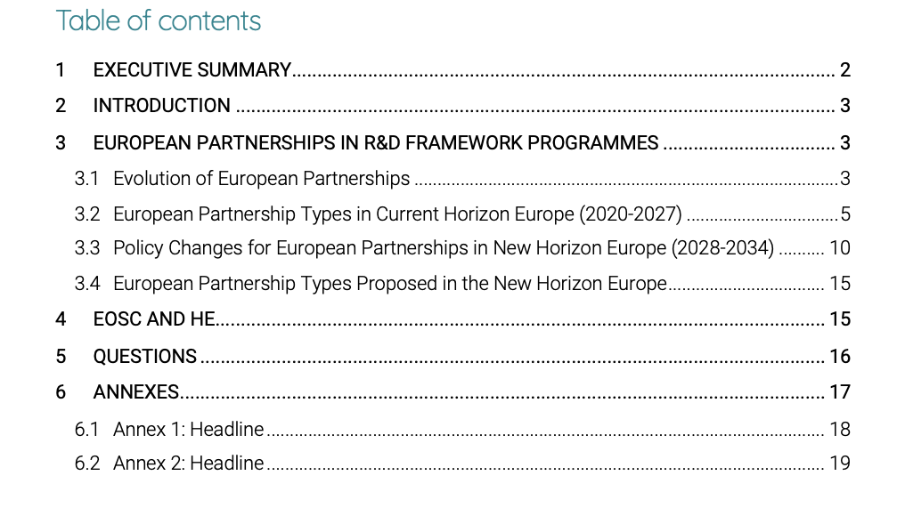
GA#12 / “Neutral Paper” explaining possible implementation routes of FP 10 for addressing EOSC post-2027
Paper E

Slide 18


Slide 19
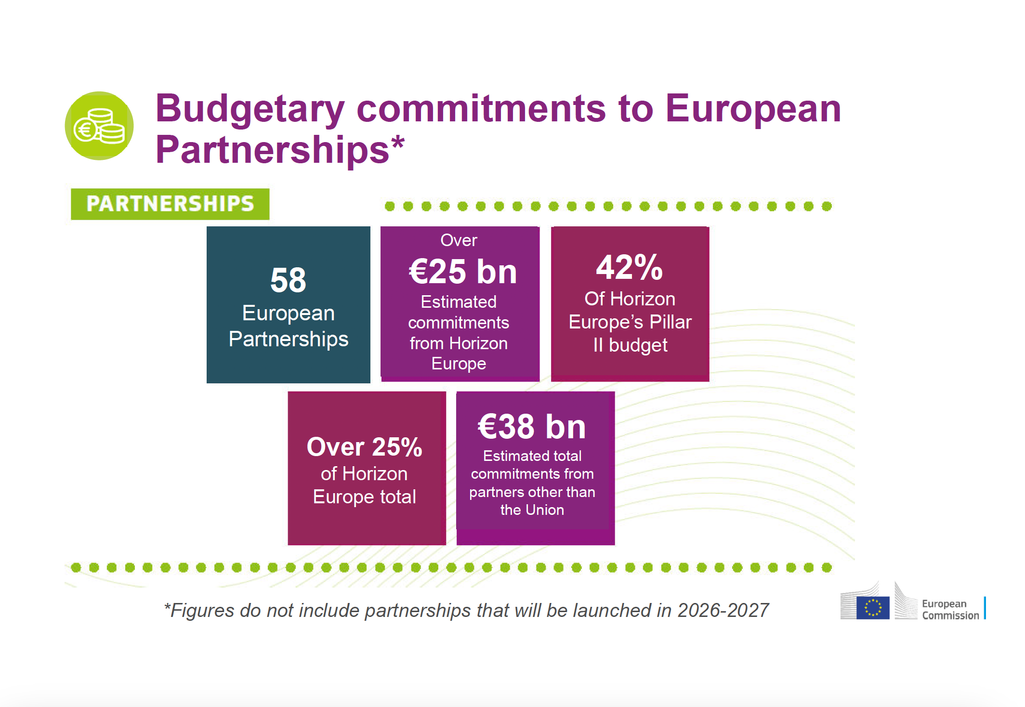
{
Protected
budget

Slide 20
Horizon Europe co-programmed EOSC Partnership
Launched June 2021
One billion euros commitment by the European Union and the EOSC Association

Slide 21

SRIA and MAR
Strategic Research and Innovation Agenda | eosc.eu/sria-mar/
Open Science practices and skills are rewarded and taught, becoming the ‘new normal’
Multi-annual roadmap sets priority activities and outcomes grouped by three implementation levels – European, National, Institutional
Three phases of MAR:
2021-2022: development towards a functional federation of infrastructure
2023-2024: expansion to production that generates added value
2025-2027: expansion to develop impact from Open Science
Standards, tools and services allow researchers to find, access, reuse and combine results
Sustainable and federated infrastructures enable open sharing of scientific results

Slide 22
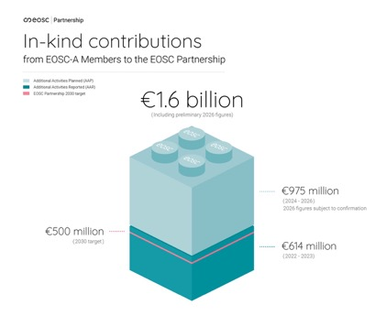
Memorandum of Understanding (2021-2030)
Commitments
The MoU is established between the Partners
The EU represented by the Commission
The EOSC Association (“Partners other than the Union”), including its constituent entities (members)
The MoU is a contractual arrangement, not legally binding
Scope & objectives
To contribute to the objectives defined in the SRIA incl. the KPIs to measure progress
Expected financial and in-kind commitments by the partners (490 MEUR + 500 MEUR)
Governance: Partnership Board
Composition: Representatives appointed by the Partners other than the Union, Commission officials and Representatives of the Steering Board
Commitments of the EC
To duly take into account the input and advice from EOSC-A when defining call topics relative to the scope and objectives of the SRIA
Commitments of EOSC-A
In-kind contributions
Monitoring and Reporting
Commitments of the European Commission
Commitments of the EOSC Association

Slide 23

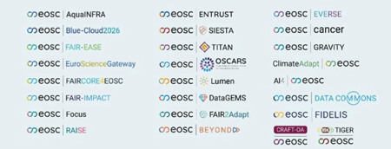
Horizon Europe co-programmed EOSC Partnership
2021 – 2027 (+ 3 additional years for closing out)
EOSC Steering Board
(legeally non-binding) Tripartite Governance
MS/AC
Expert Group of the EC
EU
Partners
EOSC-A
Partnership MoU (non-binding)
3 Objectives
< 490 MEUR EU
< 500 MEUR Inkind EOSC-A
Monitoring+Reporting
Mangement (REA)
CASH
Programme Committee
HE WP
MARs
R&I Activities
National investments in EOSC-related investments
Voluntary collaboration facilitated by EOSC-A

Slide 24
Q&A
Photo by Leeloo The First on Pexels

Slide 25
5 Tasks to be addressed in the future

Slide 26





Sustaining EOSC in practice
Task
Task
Task
Task
Task
Deploying and operating the EOSC EU Node
EOSC
Federation
Enabling a web of FAIR data and services for science
Research and prototyping new capacities for the EOSC Federation
Enabling OS policies and
the uptake of
OS practices
through EOSC

Slide 27
Boundary conditions (result of May 2025 GA)
Community stands united in its desire to lead the discussion within the Tripartite
Collective Agreement that the Federation will not run itself and therefore must be managed. Tasks 2 & 4 should be governed under Federation structures
EOSC-A as the most devoted and unbiased organisation in Europe relative to the future governance of EOSC; EOSC-A’s role lies in supervision, quality assessment, strategic guidance, ensuring that EOSC Federation evolves with user needs
Key to that division are the delineated tasks of running the basic operations of the Federation and that of driving the innovation and capacity-building essential to the Federation’s long-term sustainability.
Further discussion is needed as to how the Association could evolve in order to serve as both a management organisation and as the voice of a member-based organisation within the emerging legal framework of an EOSC Federation of Nodes

Slide 28
Plotting the 5 Tasks on the FP10 Proposal for a Work Programme based Partnership

Slide 29
Work programme based Partnership
Who?
What benefit?
Shared governance
Long-term secured EU funding
Upfront co-funding
Agreement on results to be delivered
Mechanism to agree on programming & activities
MS/AC
EU
Private
Partnership MoU
Results
Commitments
Governance
Reporting
EC to manage?
financial contribution to operational budget
‘central management’ of resources
w/ juste retour?
mechanism to discuss/agree on programming and activities.
HE WP
co-financing own participation in projects
R&I activities
e.g. reduced funding rates?

Slide 30
Work programme based Partnership without EOSC-A as Partner
MS/AC
EU
Private
Partnership MoU
Clarifications needed:
Role of EOSC-A in Governance (Strategic Tripartite vs. Partnership of Funders)
Choice of financial instruments to be used
Legal representation of EOSC Federation
Results
Commitments
Governance
Reporting
5 Tasks framed by SRIA
X MEUR
Tripartite Stipulation of role of EOSC-A
Monitoring
Fed. + Projects
‘central management’ of resources
EC/REA
EC to manage?
HE WP
MARs
mechanism to discuss/agree on programming and activities.
R&I activities
Task
Task
Task
Task
Task
EOSC Federation
Dedicated funding to resource the management and operations of the EOSC Federation as well as its contributors
Work Programme based
open calls

Slide 31
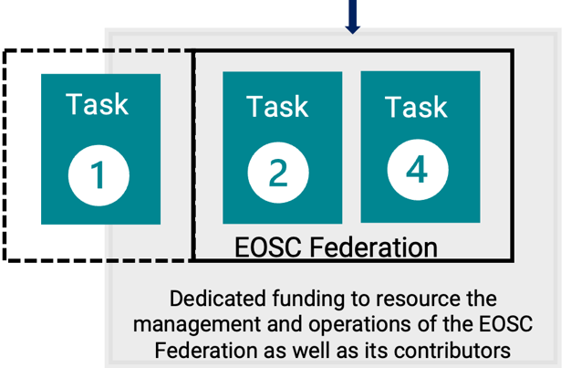
Possible Financial Instruments
To be confirmed by the EC
Framework Partnership Agreement
Identified Beneficiary with Cascading Grant Scheme
Agreement to be in place prior to MFF finalisation
No upfront funding commitment for FPA needed; funding commitment at SGA-level.
The extended duration nature of such partnership should be justified when there is a need to provide a stable environment for implementing a European initiative.
Use of procurement within SGAs as a fundamental tool for maximizing the utility of available resources and broadening the offer of state-of-the-art digital services to scientific, research and education communities.
EOSC-A to be awarded as identified single beneficiary
Dedicated resources for EOSC-A for managing and operating the EOSC Federation
EOSC-A to implement cascading grants scheme to resource contributors to the EOSC Federation.
Handling of possible EU Node procurement outside such a grant scheme
Clarifications needed:
Can FPA be used for the implementation of non-EU funding (MS/AC funding)?
Which implications have the applicable IP rules of HE?
How will the EU Node procurement be handled?

Slide 32
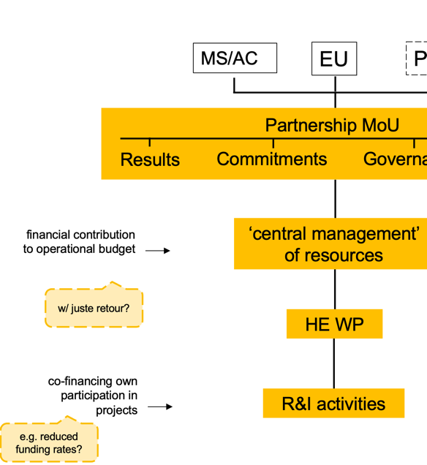
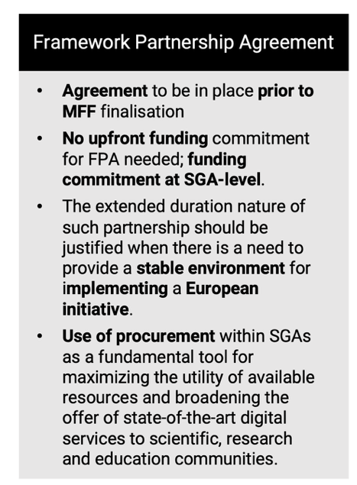
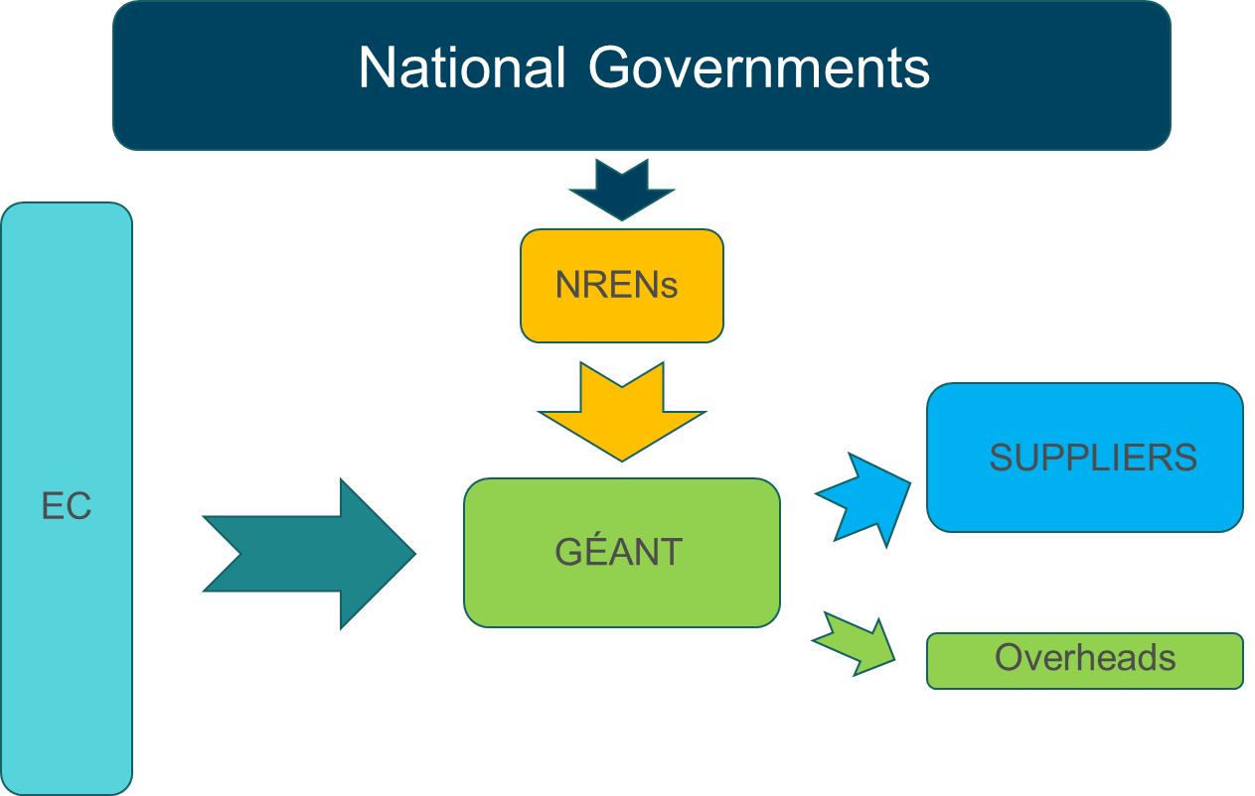
Framework Partnership Agreement
Carifications from the EC needed:
If MS/AC commit (parts of) their EOSC Node funding (both national and participation in thematic Nodes) in cash to the Partnership, would the “juste retour” take place on SGA level?
Example:
Country X supports EOSC Nodes with 100 EUR per year
50 of 100 EUR are channeled to the Partnership as the MS’ upfront cash commitment
Will these 50 EUR be sent back to the respective MS via EOSC Federation SGA?
Comparing the GÉANT case with the EOSC Federation
?
In which way would EOSC-A have to evolve, in order to become the beneficiary of an FPA dedicated to the EOSC Federation?

Slide 33
Q&A
Photo by Leeloo The First on Pexels

Slide 34
Plotting the 5 Tasks on the FP10 Proposal for a Joint Undertaking (= Institutionalised Partnership, Art. 187 TFEU)

Slide 35
Joint Undertaking
Shared governance
Long-term secured EU funding
Upfront co-funding
Agreement on results to be delivered
Mechanism to agree on programming & activities
Only for duly justified cases
Budget entrusted to JU
Single Act for JUs
MS/AC
EU
Private
Council Regulation for Joint Undertakings
Scope & commitments ready for approval by end-2026
New EU body
‘central management’ of resources by EU body
Advisory role of the community
JU Programme / activities
Potentially more flexible:
own financial Rules
governance structure
Potentially for large(r) budget
Task
Task
Task
Task
Task

Slide 36
Q&A
Photo by Leeloo The First on Pexels

Slide 37
Plotting the 5 Tasks on the “No Partnership” Scenario

Slide 38
No Partnership
Support to EOSC by HE through standard WP topics
Areas of activities identified by EC
EC may continue to seek advice by means of an expert group
Budget to EOSC topics negotiated at each programming cycle
Co-funding at HE project level, eg. reduced rates, coordinated/joint calls

Slide 39
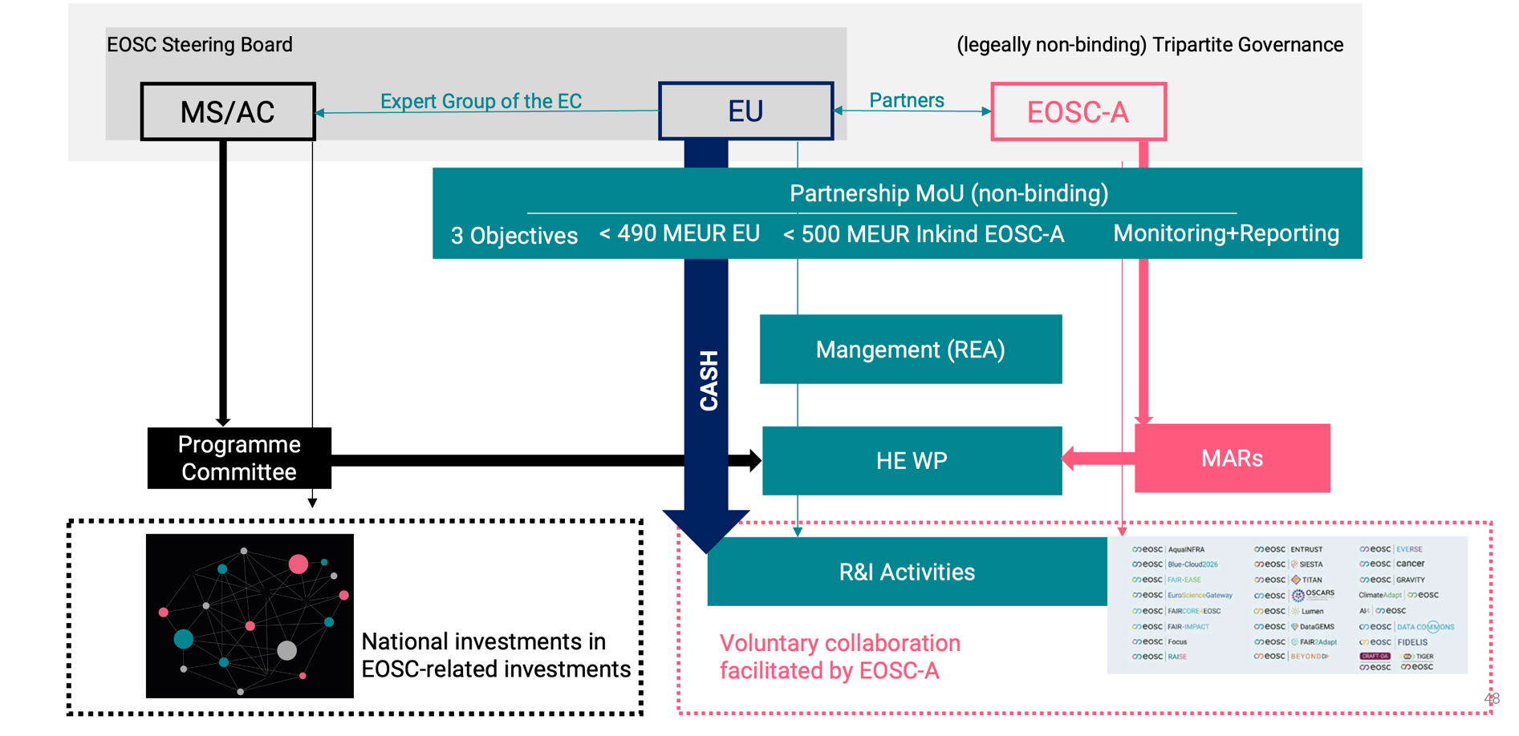
Reminder: Co-programmed Partnership

Slide 40
No Partnership Scenario
MS/AC
Expert Group of the EC
EU
Expert Group of the EC
EOSC-A
Mangement (REA)
CASH
Programme Committee
HE WP
R&I Activities
Task
Task
Task
Task
Task
Budget for EOSC topics negotiated at each programming cycle, i.e. every 2 years

Slide 41
Possible Financial Instruments
To be confirmed by the EC
Framework Partnership Agreement
Identified Beneficiary with Cascading Grant Scheme
Agreement to be in place prior to MFF finalisation
No upfront funding commitment for FPA needed; funding commitment at SGA-level.
The extended duration nature of such partnership should be justified when there is a need to provide a stable environment for implementing a European initiative.
Use of procurement within SGAs as a fundamental tool for maximizing the utility of available resources and broadening the offer of state-of-the-art digital services to scientific, research and education communities.
EOSC-A to be awarded as identified single beneficiary
Dedicated resources for EOSC-A for managing and operating the EOSC Federation
EOSC-A to implement cascading grants scheme to resource contributors to the EOSC Federation.
Handling of possible EU Node procurement outside such a grant scheme
Both Financial Instruments would work without a Partnership, however without a long-term EU funding commitment

Slide 42
Private legal entity with a public service mission
EU
Alternative implementation route of “No Partnership Scenario”
Entrusting the mangement of EU funds
Mangement
Pillar assessment needed
EOSC-A
HE WP ?
R&I Activities
Task
Task
Task
Task
Task

Slide 43
Q&A
Photo by Leeloo The First on Pexels

