Slide 1
GREN Map: High-Level Design Proposal
Ryan Davies, Software Developer | Oct 1, 2019

Slide 2
Objective
Design a system to gather, store, and consolidate data representing the GREN network
  …with a minimum of repetitive, onerous work
  …for the purpose of visualizing it

Slide 3
Challenges
Core problem: distributed data from hundreds of sources
  highly-variable source formats, e.g.
    highly-curated databases
    Ansible configurations
    spreadsheets
    human memory
    etc.
  highly-variable source data definitions, classifications, identification, availability
  multiple sources may report shared network infrastructure, resulting in duplication
  data expiry
  data not published
Work to collect and collate is onerous, and repeated by many actors many times.

Slide 4
Peer Projects
There is no current implementation that captures the entire GREN in a dynamic visualization.
Investigate parallel projects
  Collaborate and harmonize efforts
  However, the GREN map project has unique needs, as identified by our requirements gathering exercise

Slide 5
Proposed Solution
Federate data collection and curation via a flexible module that:
  ingests from various sources into a common schema
  cleans & integrates each import with other sources, if applicable
  allows manual curation after ingestion
  exports to a common format (GRENML)
  registers remote sources, if applicable, and polls routinely for fresh data (“pull” paradigm)
  logs all activity, for monitoring, debugging, and security
Once the above has been done, a reference visualization may be built upon any level of data in the hierarchy (most notably the top level).

Slide 6
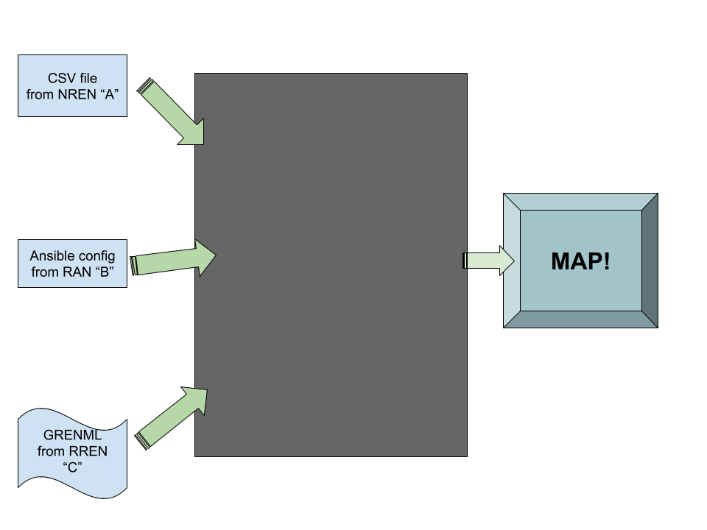
High Level
Input … “magic” … output

Slide 7
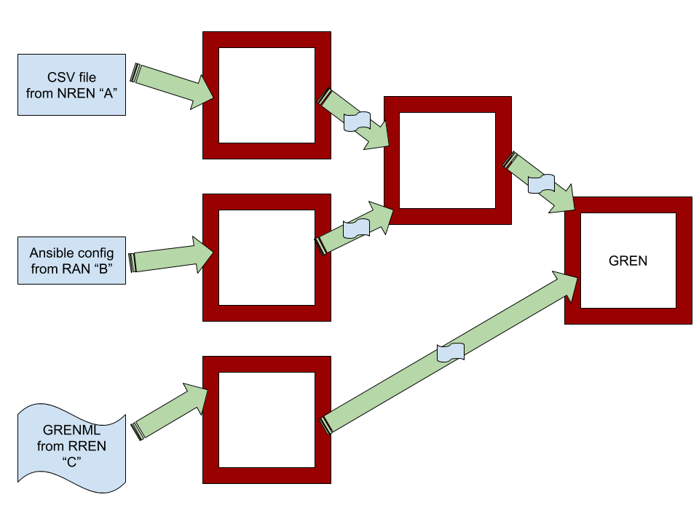
Actually…
This magic black box would be a set of magic boxes, each maintained by a REN.

Slide 8
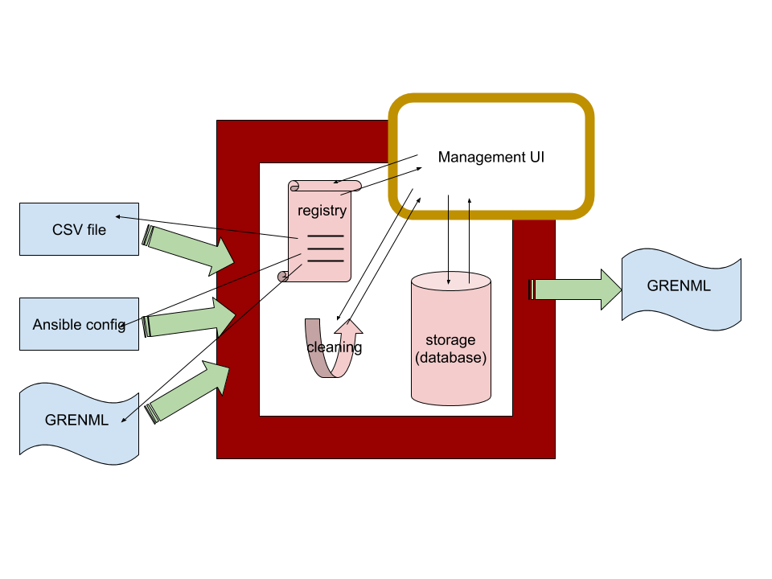
The “Flexible Module”
Core features:
  pull from and understand a variety of sources, including but not limited to spreadsheets/CSV, Ansible, and most notably, GRENML
  mechanism to resolve conflicts and missing information in the set of sources
    generally human-led resolution, remembered by the system
  store the consolidated data
  allow manual curation of the data
  publish this data to GRENML on demand
  publish this data directly for visualization
Additional features such as authentication & authorization, fault tolerance, etc.
Likely a set of Docker containers.

Slide 9
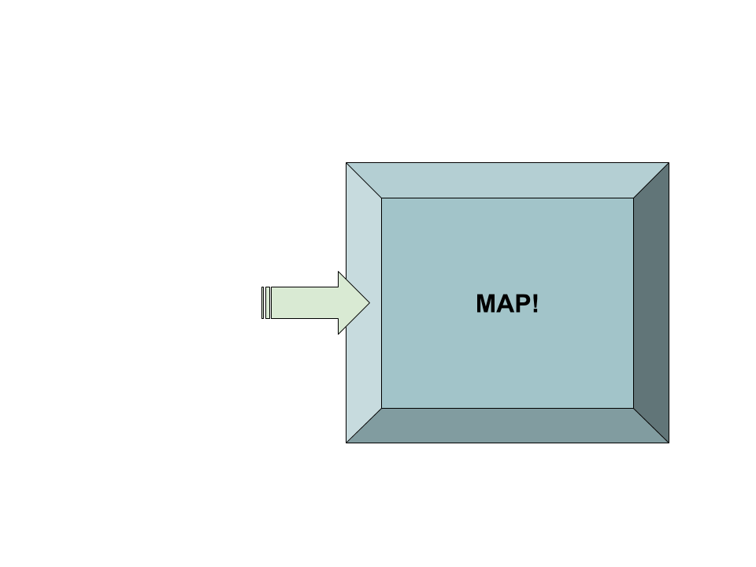
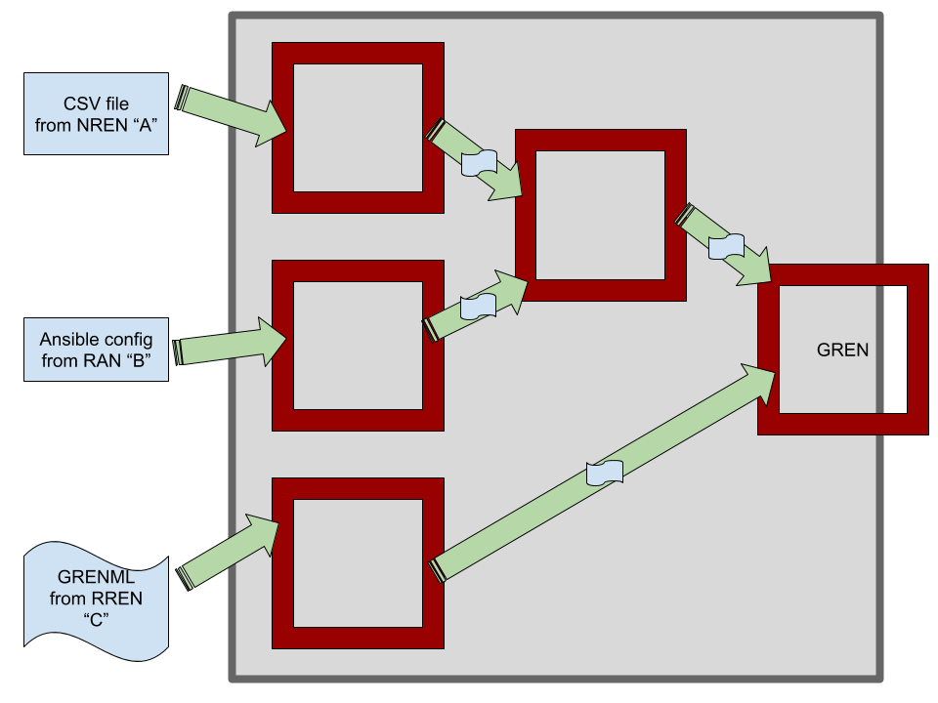
Hierarchical Federated Distribution
Every REN publishing data would be expected to have an instance of the module.
  RENs without the capacity to maintain their own instances may:
    rely on others, likely their “parents” in the hierarchy, to spin up modules on their behalf, or
    rely on their “parents” to simply publish their data (not preferred)
A consortium representing the GREN would maintain the “top” level instance module.
  This would provide the visualization of the entire GREN.

Slide 10
Module Extended Features
Data sources listed in a registry
  Various types of files, and remote GRENML sources
  For remote sources, the remote source would have the ability to manage their own entry
“Pull” vs. “push” paradigm
  Pull seemed to be more in line with expectations of system function.
Data cleaning & integration
  This is an important core problem
  Deduplication, various representations, ownership, missing data, conflicts
  Implement a set of rules, managed by a human
    “when you see this, do that”
Manual data curation would have a “preview” function

Slide 11
Participation Request
Support from the GREN community is solicited to assist in the creation various components of this module
CANARIE will identify work packages in a microservice paradigm on the following topics:
  Data ingestion
    GRENML
    CSV
    Ansible
  GRENML export
  DB: staging & published
  Management:
    API + server
    UI
  Data source registry
    Tree visualization
  Data source polling manager
  Cleaning & integration
    Registry of rules
    CRUD UI for rule management
  Authentication & authorization
    On all API endpoints
    Client for polling manager
  Visualization API + server
  Logging + visualization

Slide 12
Work Packages
Each work package would:
  be scoped between 1 FTE week and 3 FTE months
  include a set of design requirements, plus:
    existing infrastructure & documentation
    example input/output where appropriate
  indicate a required skillset for development, likely including:
    Docker
    Python
    XML
    Database ORMs
    Javascript (React) + HTML
    REST APIs
Regular communication between teams actively developing work packages and CANARIE as project co-ordinator would be encouraged.

