Slide 1
Introduction to PeeringDB
Arnold Nipper
arnold@peeringdb.com

Slide 2
What is PeeringDB?
Mission statement: “PeeringDB, a nonprofit member-based organization, facilitates the exchange of user maintained interconnection related information, primarily for Peering Coordinators and Internet Exchange, Facility, and Network Operators.”

Slide 3
Why should I have a record in PeeringDB?
As a network, a PeeringDB record makes it easy for other networks to find you, and helps you to establish peering / interconnection
As a colocation provider, a PeeringDB record creates visibility, and helps you to attract additional networks and IXes
As an IX, a PeeringDB record provides information about your participants, and colocations where your service is available
Provides a user friendly GUI and a powerful API for automatisation
?
…

Slide 4
Governance and Membership
PeeringDB is a United States 501(c)(6) volunteer organization that is 100% funded by sponsorships
Healthy organization, building financial reserves and executing the long term strategic plan
Membership rules
A corporation, limited liability company, partnership or other legal business entity may be a Member of the Corporation
Membership is determined by having both an active PeeringDB.com account and an individual representative or role subscription to the PeeringDB Governance mailing list
359 addresses subscribed to the Governance mailing list (as of Nov 30, 2021)
Governance list is at http://lists.peeringdb.com/cgi-bin/mailman/listinfo/pdb-gov
More information available at http://gov.peeringdb.com/

Slide 5
Governance
The Members
Any corporation, limited liability company, partnership or other legal business entity may be a Member
One (virtual / online) member meeting per year
The Board
Sets strategic directions and overlooks financial issues
Half of the board is elected every year
The Committees
Responsible for the day-to-day work
Admin Committee
Operations Committee
Outreach Committee
Product Committee

Slide 6






Board of Directors and Officers
Chris Caputo – Secretary & Treasurer (Non-Board Member) | Patrick Gilmore – Director (Term Expires 2023) | Aaron Hughes – President (Term Expires 2022)
Christopher Malayter – Director (Term Expires 2023) | Bijal Sanghani – Director (Term Expires 2023) | Job Snijders – Vice President (Term Expires 2022)

Slide 7
Committees
Admin Committee | Operations Committee | Outreach Committee | Product Committee
Manage administration of user accounts and PeeringDB records Answer support tickets Cleansing and completion of PeeringDB records Leads: Patrick Gilmore (Chair) and Darwin Costa (Vice Chair) Contact: admincom@ lists.peeringdb.com | Manage PeeringDB infrastructure Leads: Job Snijders (Chair) and Aaron Hughes (Vice Chair) Contact: pdb-ops@ lists.peeringdb.com | Manage marketing and social media Develop and maintain presentations, workshops and webinars Coordinate presentations and attendance at events Leads: Ben Ryall (Chair) and Bijal Sanghani (Vice Chair) Contact: outreachcom@ lists.peeringdb.com | Manage roadmap and development priorities Ask for input from the community on desired features Write SoWs to solicit bids to complete requested features Leads: Stephen McManus (Chair) and Matt Griswold (Vice Chair) Product Manager: Leo Vegoda Contact: productcom@ lists.peeringdb.com

Slide 8
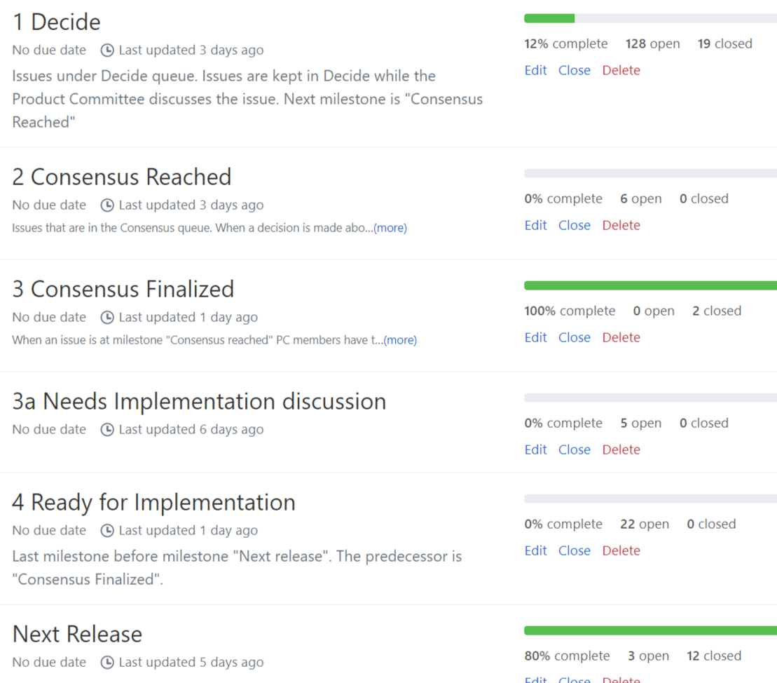
Product Development Workflow
All issues tracked using GitHub at https://github.com/peeringdb/peeringdb/issues
Anyone can open a feature requests or file a bug report
Open and transparent process for product development
Workflow is at http://docs.peeringdb.com/workflow/
Product Committee issue process
Evaluate and prioritize the requests
Request a quote for development costs
Request budget from the board
Manage implementation and scheduling
Your input is needed on features!

Slide 9
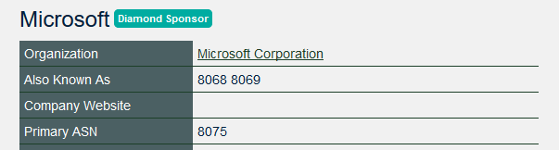

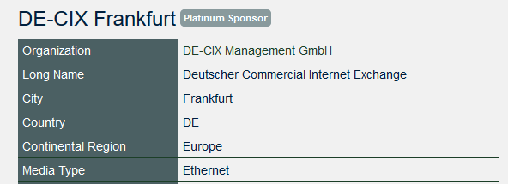



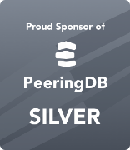
Become a PeeringDB Sponsor!
Diamond Sponsorship - $25,000 / year
Limited to 2 sponsors
Very large logo on top line of Sponsors page with URL
Diamond Sponsor badge display on all records
Social media promotion
Platinum Sponsorship - $10,000 / year
Large logo on second line of Sponsors page with URL
Platinum Sponsor badge display on all records
Social media promotion
Gold Sponsorship - $5,000 / year
Medium logo on third line of Sponsors page
Gold Sponsor badge display on all records
Social media promotion
Silver Sponsorship - $2,500 / year
Small logo on fourth line of Sponsors page
Silver Sponsor badge display on all records
Social media promotion
Contact sponsorship@peeringdb.com for sponsorship info!

Slide 10








































Thank you to our sponsors!
Diamond Sponsor
Platinum Sponsors
Gold Sponsors
Silver Sponsors
Notes:
Logo height proportions: 100%, 85%, 65%, 40%

Slide 11
Registering

Slide 12
Registering
Once your email is confirmed:
Get affiliated with an organization
Your company
Which is already in PeeringDB
Or is new to PeeringDB
Can be an ISP – enter your AS number!
Or a Datacenter
Or an Internet Exchange
645XX
Some Name
Notes:
Trainer: Make sure private AS validation is either „off“ or AS numbers 64501-64520 are pre-entered in the database:
use URL http://localhost:2002/cp/peeringdb_server/network/add/ but add only AS number and name
Put 0 into ipv4 and ipv6 prefixes
Klick on the „+“ beside „Organisation“ and add an Organisation as well

Slide 13
Registering
Once approved, you can edit your organization
Click on your organization to continue...
Notes:
Trainer:
Approve pending affiliate requests
URL is /cp/peeringdb_server/userorgaffiliationrequest/
Or search for „User to Organisation Affiliation Requests“
Click on the user name
Set status to
Click on „Add user to Organisation...“approved“
Click on save

Slide 14
Your Organization
Enter information about your organization – click on edit

Slide 15
Network Information
Now it gets interesting
With your basic company information now in, let‘s add information about your network
Click on your network name – beside your AS number on the right side

Slide 16
Network Information
Again, click on „Edit“ (top right)
Here is a lot of information to enter
Most is self-explanatory
But some is not that obvious
Title here is your network name
Does not have to be the same as your company name
Some companies run more than one network
Or use a different name for their networking business

Slide 17
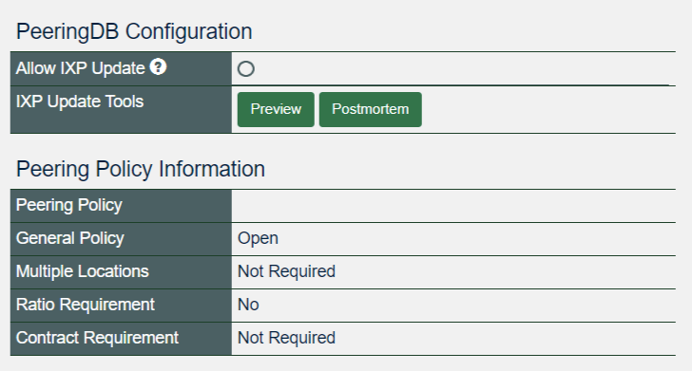
Peering Information
Allow IXP Update
here
Now we add information about Peering!
Important: Allowing IXP Update helps maintaining DB accuracy
So please allow if you trust your IXPs
You trust either all or none
Notes:
Trainer: If you want to talk about peering policies around, now is the time

Slide 18
Contact Information
To inform peers how to contact you
In a number of roles
You can add as many as you need
„Add Contact“ to save a contact
Public; for logged-in users
You do not have to fill out all fields
Keep contact info up to date
Mandatory if you want to add a connection to an IXP
Notes:
Users have to click „add contact“ and „save“ to store contacts

Slide 19
Add peering at an IXP
Click on „Edit“ at the top right again
Enter an IXP name in Exchange
And select the IXP you are connected to from the list
Enter speed, IPv4 and IPv6
Select “RS Peer“ if you are peering with the route server
Click on „Add Exchange Point“!
And then click on „save“.

Slide 20
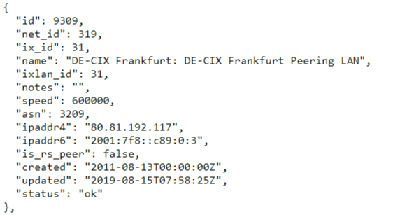
Data Ownership
How to resolve conflicts when more than one party is involved?
Ex.: netixlan
A Task Force created a policy document
Recommendations incorporated in latest releases
Maintained by net
Assigned by ix

Slide 21
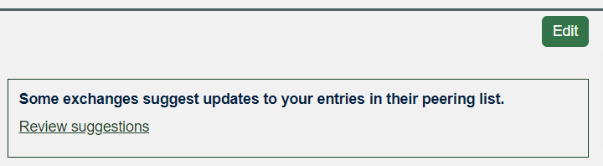
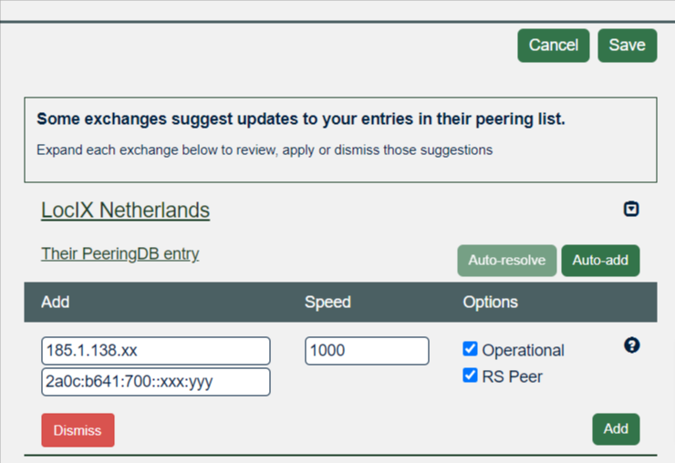
Suggested Entries
Go to your network page
Click on „Review suggestions“
You see a list of IX with sugestions
Select one
You have a couple of choices
Auto-add: add entry as suggested
Auto-resolve: resolve as suggested
Dismiss: ignore suggestion

Slide 22
Presence at a datacenter
Now again click on „edit“
Scroll down and enter a city or datacenter name in „Facility“
Select the facility you are in from the list and....
...click on „Add Facility“
When you have added all facilites click on „Save“

Slide 23
Add your facility
If you run your own datacenter
Why not add it to PeeringDB?
Go to your organization page
Scroll down to „Manage“
Choose „Add Facility“

Slide 24
Suggesting a facility
For facilities not your own
But you are in or know about
Choose „Suggest Facility“
Is reviewed by PeeringDB staff

Slide 25
Adding users
You do not have to be the only person working with PeeringDB
Other users from your organization may also register!
Users can be „admin“ or „member“
The first user automatically will be assigned „admin“ status if authenticated
Administrators are allowed to edit all fields (of your organization)
Members rights can be as restrictive or as open as you need them to be

Slide 26
User administration
Users can be admins or members
Use the dropdown to change
For members – you can add permissions
Use the permissions tab to grant create, update and/or delete to selected of any entities
Do not forget to „save“ your changes

Slide 27
Removing Users
Be sure you are logged in as an admin
Go to your organization page
Scroll down to the „manage“ section
Click on the „Users“ tab
Click on „Remove“ on the right side
And do not forget to „save“
The user is only deleted from your organization
If you want to remove a user completely, email PeeringDB support

Slide 28
More removing...
If you leave an internet exchange: – please remove your peering IP addresses
Go to your network page
Click on „Edit“ (top right)
Click on the beside the entry of the exchange
Confirm and do not forget to „Save“

Slide 29
More removing...
Facilities, Contacts, all the same
Click on „Edit“
Click on the remove symbol at the entry
Click on “Save“

Slide 30
Removing – more information
Objects are only marked deleted, but stay in the DB
Facilities and IXes only can be removed if they don‘t have participants
You cannot simply re-add them
Please contact support@peeringdb.com if you need help

Slide 31
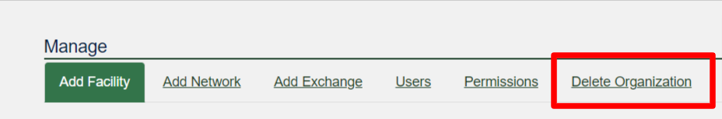
Removing your organization
Iff you dissolve your organization
You first have to „empty“ your IXes and Facilities
Please contact support@peeringdb.com if you need help

Slide 32
The PeeringDB API

Slide 33
Introduction
Why API (Application Programming Interface)?
The GUI is nice for human beings
Automation needs structured data
Makes it easy to integrate PeeringDB in your environment

Slide 34
jq
Light-weight and flexible command-line processor
awk, sed and grep equivalent to JSON data
A jq program is a filter
Needs an input and produces anoutput
Maybe piped
Looks weird sometimes, like „add/length“ produces average of an array
Simplest filter is „.“ which is the Identity
Maybe used to pretty print JSON output
See https://stedolan.github.io/jq/manual for an introduction
Ex: curl -sG https://peeringdb.com/api/org --data-urlencode fields=id | jq -c '[.data[] | .id] | length'

Slide 35
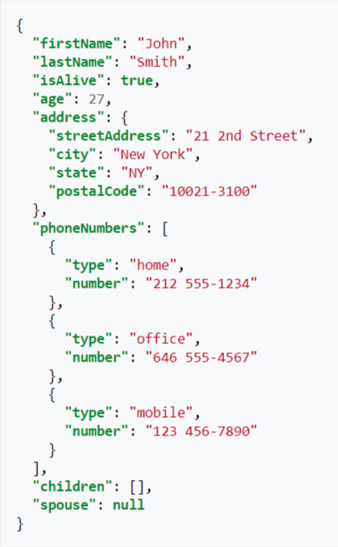
JSON
Open standard file format
Short for JavaScript Object Notation
Filenames use the extension .json
Language independent data format
Basic data types
Number
String
Boolean
Array
Object
null

Slide 36
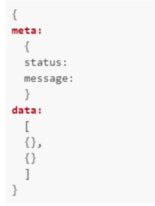
Basics
In general https://peeringdb.com/api/OBJ
OBJ is case insensitive
So called endpoint: /api/OBJ
Output always fits in one object
Meta is optional
Data always an array

Slide 37
Authentication
Authentication
basic HTTP authorization
API keys
Guest access does not need any authentication
Examples
curl -sG https://username:password@peeringdb.com/api/poc
curl -u username:password https://peeringdb.com/api/poc
Recap: only access to contact information may be restricted
Endpoint /api/poc
You need to be authenticated to view objects with visibility „Users“

Slide 38
Operations
All HTML operations are supported
GET
Requests a representation of the specified resource
POST
Used to submit an entity to the specified resource
PUT
Replaces all current representations of the target resource with the request payload
DELETE
Deletes the specified resource

Slide 39
Nested Data / Depth
Of type OBJ_set
Example: net_set will hold network objects
Depth (for endpoint /api/OBJ)
0: don't expand anything (default)
1: expand all first level sets to ids
2: expand all first level sets to objects
Depth (for endpoint /api/OBJ/id)
0: don’t exand anything
1-4: expand all sets and related objects according to level of depth specified
2 is default

Slide 40
Query modifiers
numeric fields
__lt: less than
__lte: less than equal
__gt: greater than
__gte: greater than equal
__in: value inside set of values (comma separated)
string fields
__contains: field value contains this value
__startswith: field value starts with this value
__in: value inside set of values (comma separated)

Slide 41
Object Types
Basic Objects
org, fac, ix, net, poc, as_set
Derived Objects
ixfac, ixlan, ixpfx, netixlan, netfac

Slide 42
Basic Objects
org
Root object for fac, ix, net
Holds information about organisation
fac
Describes a facility / colocation record
More useful information are in derived records netfac
ix
Describes an Internet Exchange
More useful information are in derived records ixlan, ixpfx and netixlan
net
Describes a network / ASN
More useful information are in netfac and netixlan
poc
Describes various role accounts (point of contact)
Currently only for net objects
as_set
Array of all AS-SETs corresponding to a network / ASN
Only introduced recently

Slide 43
Derived Objects
ixfac
Describes the presence of an IX in a facility
ixlan
Describes the LAN of an IX
Will go away with PeeringDB 3.0. Hence, already tightly coupled to ix
ixpfx
Describes the IP range (IPv4 and IPv6) for an ixlan
One ixlan may have multiple ixpfx, both for IPv4 and IPv6
netixlan
Describes the presence of a network at an IX
netfac
Describes the presence of a network at a facility

Slide 44
Examples
# Fetch asn, ipaddr4, ipaddr6, speed from all peers at an IXP. Then fetch correspondant Technical Contacts
#
IXPID=986
curl –sG https://peeringdb.com/api/netixlan?ix_id=$IXPID > tmp0
jq –r '. data[] | .net_id, .asn, .ipaddr4, .ipaddr6, .speed ' tmp0| paste - - - - - > tmp1
# For the poc we need the net_ids of the ASN. The API allows to query all poc at once by providing all net_ids
NETIDLST=$(jq -r '[.data[] | .net_id ] | unique | @csv' tmp0)
curl –snG https://peeringdb.com/api/poc?net_id__in=$NETIDLST | jq –r '.data[] | select (((.role == “Technical") or (.role == “Policy")) and (.email != "")) | .net_id, .email, .role' | paste - - - | sort –mu > tmp2
# Merging poc data and connection data is left as an exercise

