Slide 1
Mutually Agreed Norms for Routing Security
Steven Wallace
ssw@internet2.edu

Slide 2
Why Does Routing Security Matter?
A Routing Overview

Slide 3

The Honor System: Routing Issues
Border Gateway Protocol (BGP) is based entirely on trust between networks
  Created before security was a concern
  Assumes all networks are trustworthy
  No built-in validation that updates are legitimate
  The chain of trust spans continents
  Lack of reliable resource data

Slide 4
Routing Incidents Happen Across the Internet
In 2019 alone, over 10,000 routing outages or attacks – such as hijacking, leaks, and spoofing – led to a range of problems including stolen data, lost revenue, reputational damage, and more.
About 40% of all network incidents are attacks; 3.8% of all Autonomous Systems on the Internet were affected.
Incidents are global in scale, with one operator’s routing problems cascading to impact others.
https://www.manrs.org/2019/02/routing-security-getting-better-but-no-reason-to-rest/
Notes:
The Internet’s routing foundation has cracks, and they’re growing.
Routing security is vital to the future and stability of the Internet, and the global MANRS initiative implements the crucial fixes needed to eliminate the most common malicious or incidental routing threats.
Resources:
http://www.manrs.org/2018/01/14000-incidents-a-2017-routing-security-year-in-review/
https://bgpstream.com/

Slide 5
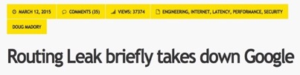
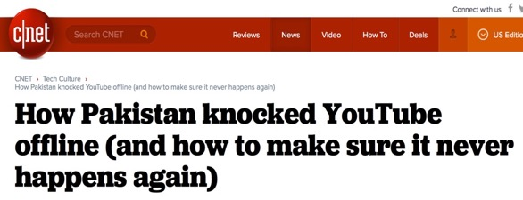



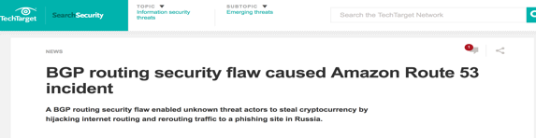
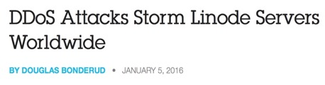




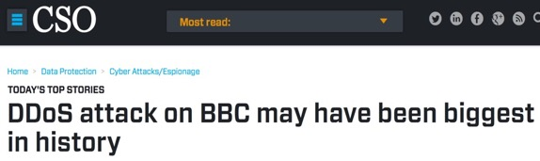


Routing Incidents Cause Real World Problems
Insecure routing is one of the most common paths for malicious threats.
Attacks can take anywhere from hours to months to recognize.
Inadvertent errors can take entire countries offline, while attackers can steal an individual’s data or hold an organization’s network hostage.
Notes:
The threat is real and the need for a fix urgent
MANRS will halt the most common causes of routing incidents
Resources:
Generic Threats to Routing Protocols: https://www.ietf.org/rfc/rfc4593.txt

Slide 6
What are Routing Incidents?
A Routing Security Overview

Slide 7
The Threats: What’s Happening?
Event | Explanation | Repercussions | Solution
Prefix/Route Hijacking | A network operator or attacker impersonates another network operator, pretending that a server or network is their client. | Packets are forwarded to the wrong place; this can cause Denial of Service (DoS) attacks or traffic interception. | Stronger filtering policies
Route Leak | A network operator with multiple upstream providers announces (often due to accidental misconfiguration) to one upstream provider that is has a route to a destination through the other upstream provider. | Can be used for traffic inspection and reconnaissance. | Stronger filtering policies
IP Address Spoofing | Someone creates IP packets with a false source IP address to hide the identity of the sender or to impersonate another computing system. | The root cause of reflection DDoS attacks. | Source address validation
Notes:
This is a summary of the following three slides. (Depending on the audience, you can use this one slide, OR the other three, and don’t need all four slides.)

Slide 8

Tools to Help
  Prefix and AS-PATH filtering
  RPKI validator, IRR toolset, IRRPT, BGPQ3
  BGPSEC
But…
  Not enough deployment
  Lack of reliable data
  We need concerted action to improve routing security.
Notes:
There are various tools to help but they are not deployed often enough and therefore the data is not reliable.

Slide 9

We Are In This Together
Network operators have a responsibility to ensure a globally robust and secure routing infrastructure.
Your network’s safety depends on a routing infrastructure that weeds out bad actors and accidental misconfigurations that wreak havoc on the Internet.
The more network operators work together, the fewer incidents there will be, and the less damage they can do.

Slide 10
The Solution: Mutually Agreed Norms for Routing Security (MANRS)
Provides crucial fixes to reduce the most common routing threats

Slide 11
MANRS improves the security and reliability of the global Internet routing system, based on collaboration among participants and shared responsibility for the Internet infrastructure.
MANRS sets a new norm for routing security.

Slide 12
MANRS Programmes
Network
Operators
Internet Exchange Points
Content Delivery Networks (CDNs) and Cloud Providers

Slide 13
MANRS Network Operators Programme
Launched in 2014 by a handful of network operators with the following goals:
Raise awareness of routing security problems and encourage the implementation of actions that can address them.
Promote a culture of collective responsibility toward the security and resilience of the Internet’s global routing system.
Demonstrate the ability of the Internet industry to address routing security problems.
Provide a framework for network operators to better understand and address issues relating to the security and resilience of the Internet’s global routing system.

Slide 14
MANRS Actions for Network Operators
Filtering
Prevent propagation of incorrect routing information
  Ensure the correctness of your own announcements and announcements from your customers to adjacent networks with prefix and AS-path granularity
Anti-spoofing
Prevent traffic with spoofed source IP addresses
  Enable source address validation for at least single-homed stub customer networks, their own end-users, and infrastructure
Coordination
Facilitate global operational communication and coordination between network operators
  Maintain globally accessible, up-to-date contact information in common routing databases
Global Validation
Facilitate validation of routing information on a global scale
  Publish your data so others can validate
Blue shading = Mandatory Action

Slide 15
MANRS IXP Programme
Internet Exchange Points (IXPs) are a collaborative focal point to discuss and promote the importance of routing security.
Launched in 2018, the IXP Programme addresses the unique needs and concerns of IXPs with a separate set of MANRS actions.
IXPs can implement actions that demonstrate their commitment to routing security and bring significant improvement to the resilience and security of their peering relationships.

Slide 16
MANRS Actions for Internet Exchange Points
Action 1
Prevent propagation of incorrect routing information
  Implement filtering of route announcements at the Route Server based on routing information data (IRR and/or RPKI).
Action 2
Promote MANRS to the IXP membership
  Provide encouragement or assistance for IXP members to implement MANRS actions.
Action 3
Protect the peering platform
  Have a published policy of traffic not allowed on the peering fabric and perform filtering of such traffic.
Action 4
Facilitate global operational communication and coordination
  Facilitate communication among members by providing necessary mailing lists and member directories.
Action 5
Provide monitoring and debugging tools to the members.
  Provide a looking glass for IXP members.
Blue shading = Mandatory Action

Slide 17
MANRS CDN and Cloud Programme
Launched in 2020, the CDN and Cloud Provider Programme helps by requiring egress routing controls so networks can prevent incidents from happening.
Leveraging CDNs’ and cloud providers’ peering power can have significant positive spillover effect on the routing hygiene of networks they peer with.
Goals include:
Create a secure network peering environment
Encourage better routing hygiene from peering partners
Demonstrate responsible behavior
Improve operational efficiency for peering interconnections, minimizing incidents and providing more granular insight for troubleshooting

Slide 18
MANRS Actions for CDNs & Cloud Providers
Action 1
Prevent propagation of incorrect routing information
  Ensure correctness of own announcements and of their peers (non-transit) by implementing explicit (whitelist) filtering with prefix granularity.
Action 2
Prevent traffic with illegitimate source IP addresses
  Implement anti-spoofing controls to prevent packets with illegitimate source IP address from leaving the network (egress filters).
Action 3
Facilitate global operational communication and coordination
Maintain globally accessible, up-to-date contact information in PeeringDB and relevant RIR databases.
Action 4
Facilitate validation of routing information on a global scale
  Publicly document ASNs and prefixes that are intended to be advertised to external parties (IRR and/or RPKI)
Action 5
Encourage MANRS adoption
Actively encourage MANRS adoption among the peers.
Action 6
Provide monitoring and debugging tools to the peering partners
  Provide a mechanism to inform peering partners if announcements did not meet the requirements of the peering policy.
Blue shading = Mandatory Action

Slide 19
The Business Case for MANRS
and Routing Security
Notes:
https://www.manrs.org/wp-content/uploads/sites/14/2017/10/MANRS-451-Study-Report.pdf

Slide 20
Why Research & Education Networks Should Join MANRS
To show technical leadership and distinguish you from commercial ISPs
  Customers increasingly willing to pay more for secure services
To add competitive value and enhance operational effectiveness
  Growing demand from customers for managed security services
To show security proficiency and commitment to your customers
  Promote MANRS compliance to security-focused customers
To help solve global network problems
  NRENs are often early adopters of new developments. Lead by example and improve routing security for everyone
  Being part of the MANRS community can strengthen enterprise security credentials

Slide 21
Learn More and
Join Us

Slide 22
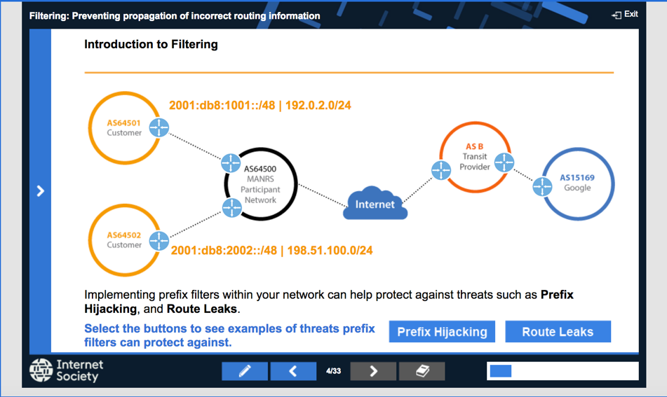
Help Is Available
If you’re not ready to join yet, implementation guidance is available to help you.
Implementation Guide based on Best Current Operational Practices deployed by network operators around the world
Tutorial modules based on information in the Implementation Guide.

Slide 23
MANRS Implementation Guide for Network Operators
If you’re not ready to join yet, implementation guidance is available to help you.
Based on Best Current Operational Practices deployed by network operators around the world
Recognition from the RIPE community by being published as RIPE-706
  https://www.manrs.org/bcop/

Slide 24

MANRS Tutorials
Tutorials based on information in the Implementation Guide
Walks through the tutorial with a test at the end of each module
Working with and looking for partners that are interested in integrating it in their curricula
https://www.manrs.org/tutorials

Slide 25

Join Us
Visit https://www.manrs.org
  Fill out the form with as much detail as possible.
  We will ask questions and run tests
Get Involved in the Community
  Members support the initiative and implement the actions in their own networks
  Members maintain and improve the documents and promote MANRS objectives

Slide 26



LEARN MORE:
https://www.manrs.org
FOLLOW US:
/RoutingMANRS

Slide 27
Some Observations from the US R&E Community:
IPv6 implementation still low, with ~28% of originating ASNs announcing IPv6 routes
1,300+ Internet2-connected organizations announce legacy IPv4 space (~66% of prefixes received by Internet2), unable to participate in RPKI!
IRR use much better, with 98% of received prefixes having matching/covering route objects and in announced as-cone. Thanks Google!

Slide 28
Some Observations from the US R&E Community:
Per-regional (aka Internet2 Connector) reports helpful
Blend of regional & campus approach to IRR
Routing Security practice has plateaued, now exploring routing security assessment approach

